Slide 1
Data visualization and Interaction on Small Screen of Smartwatches
HCI lab meeting
Dec 2019
Notes:
Hi All
Today and first of all I’m going to be talking about my research area briefly and then we want to talk about an idea that Bradley, Sandra, and I are working on it now.
So as you probably know, my research area is about data visualization and interaction on smartwatches.

Slide 2
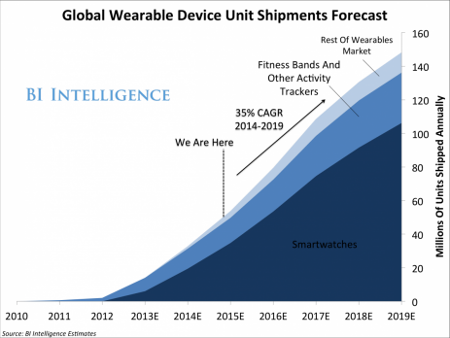
Notes:
Why smartwatches are important?
Based on the information we have it’s a huge market and the number of people using smartwatches is increasing significantly.
So it recently grabbed the attention of researchers from different domains such as HCI

Slide 3
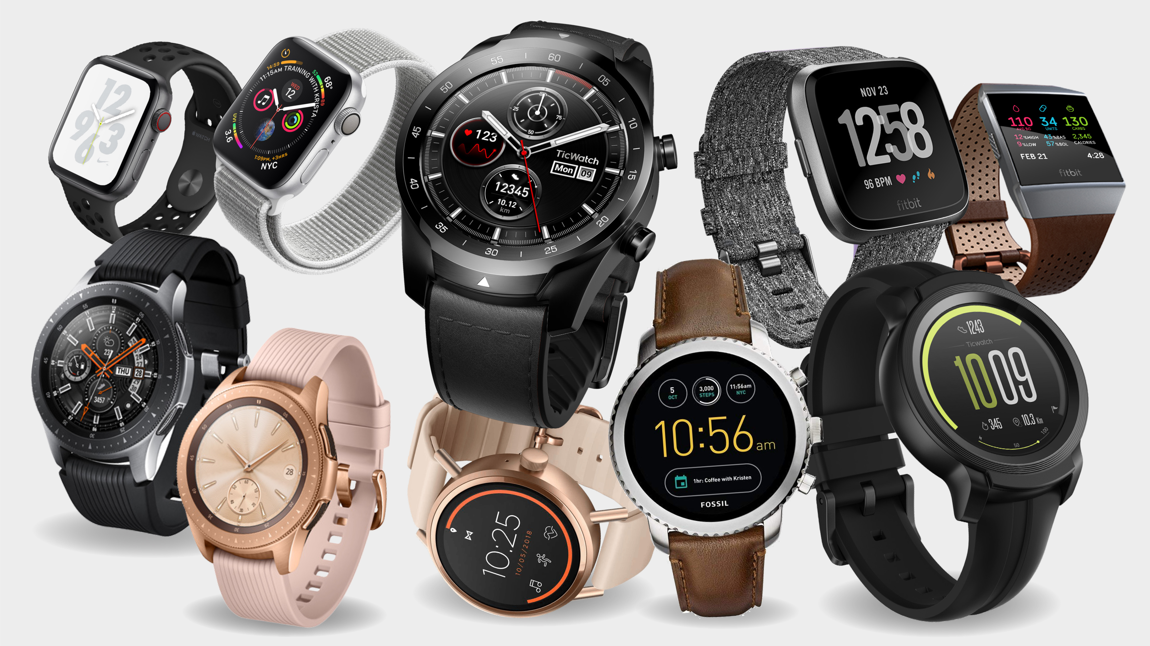
Notes:
Like many other new technologies, smartwatches have their own challenges
Smartwatches have many features that make them unique compared to other wearable devices
So in my next few slides I will be talking about these features as well as some of my recent research topics

Slide 4
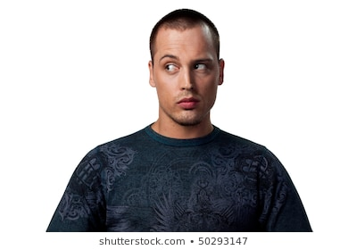
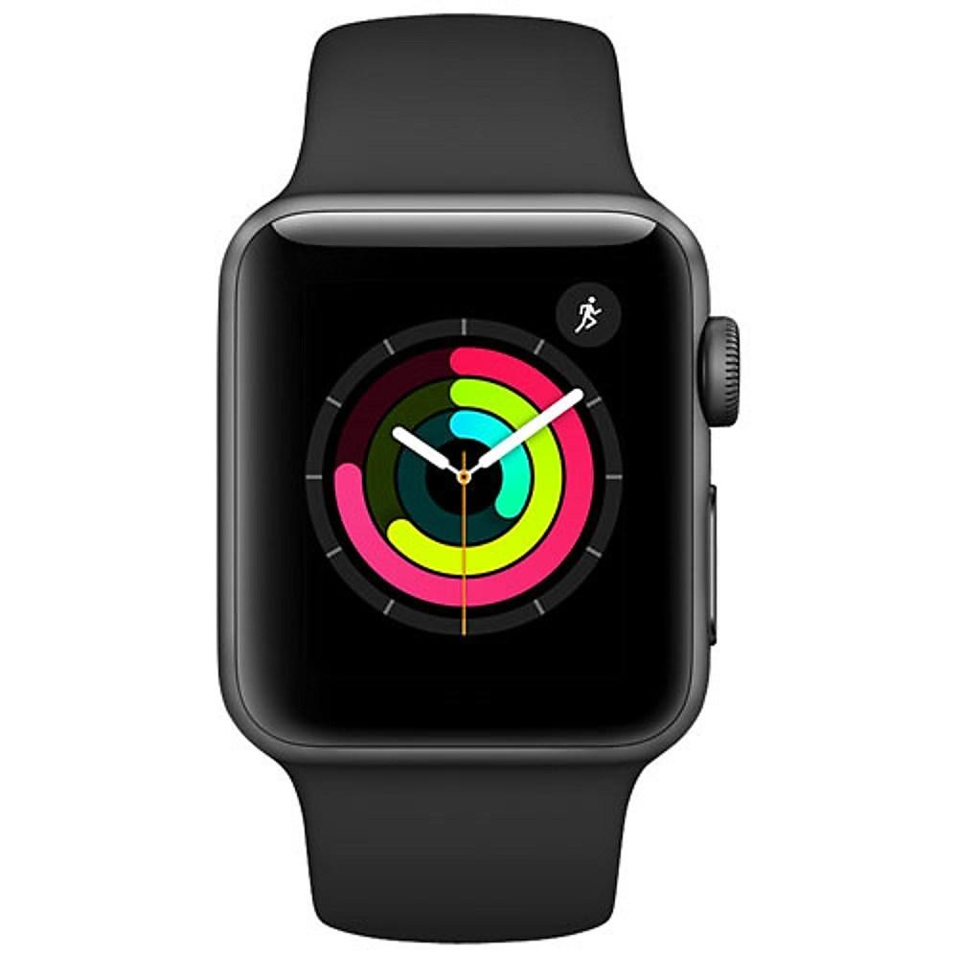
Glanceable Wearables
Notes:
First of all
Smartwatches are glanceable devices which means that the message should be conveyed to the user as soon as possible
So basically your smartwatch is not like a divice you want to analyse the data or you want to spend too much of your time to get in depth insight out of the collected data.
As HCI researchers we want to make sure we can deliver the message as quickly as possible with proper techniques

Slide 5
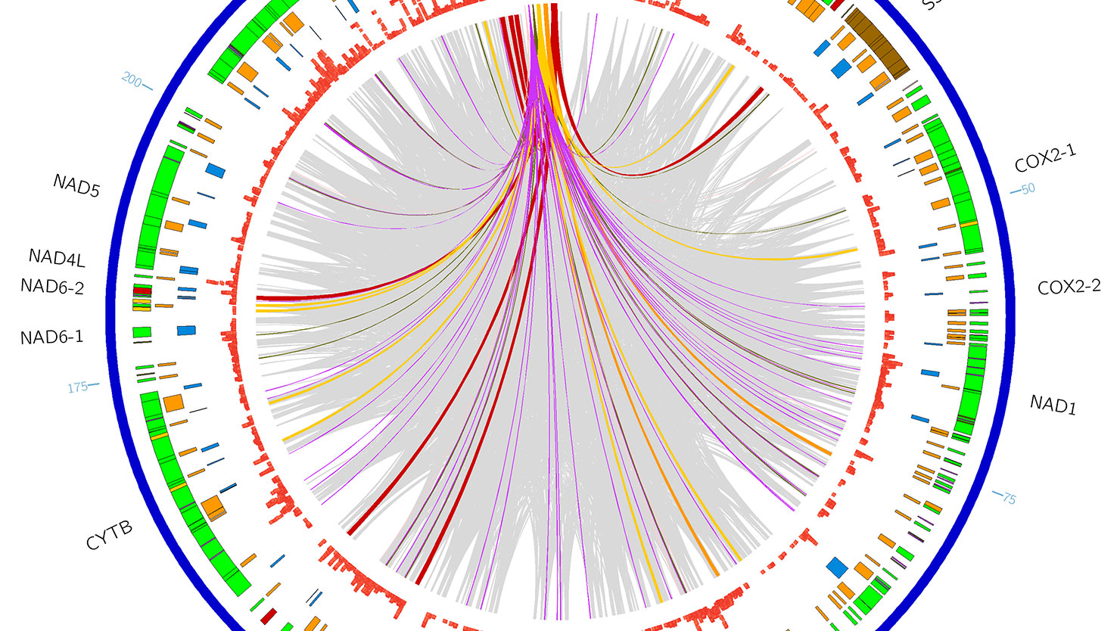
Notes:
There are tons of visualization techniques. However, many of them are complex and not proper to be deployed on the smartwatch

Slide 6
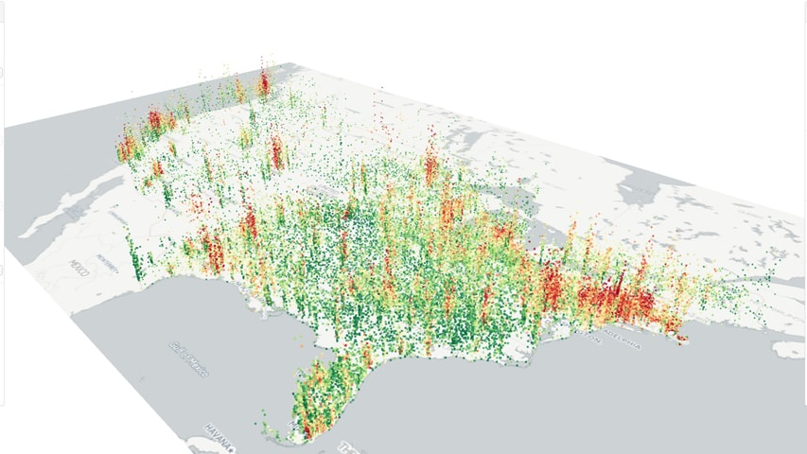

Slide 7
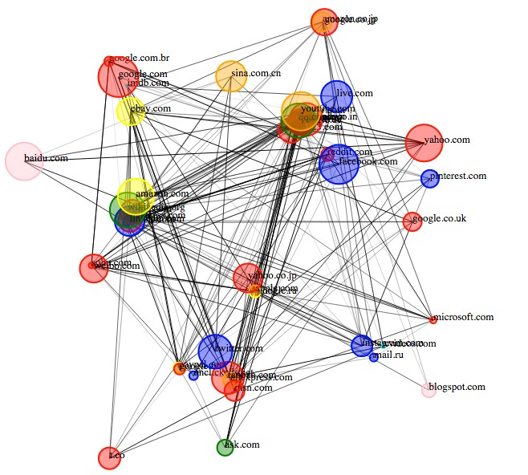

Slide 8
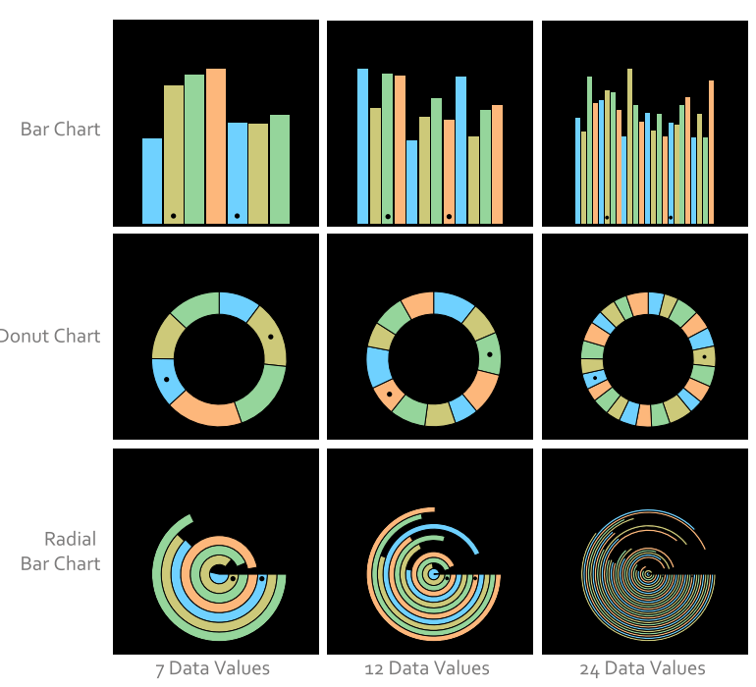

Blascheck T, Besançon L, Bezerianos A, Lee B, Isenberg P. Glanceable Visualization: Studies of Data Comparison Performance on Smartwatches. IEEE transactions on visualization and computer graphics.
Notes:
Also in a paper, researchers investigated 3 of the most commonly used data visualization techniques on smartwatches with different density levels. These graphs are line chart, bar chart and radial bar graph

Slide 9
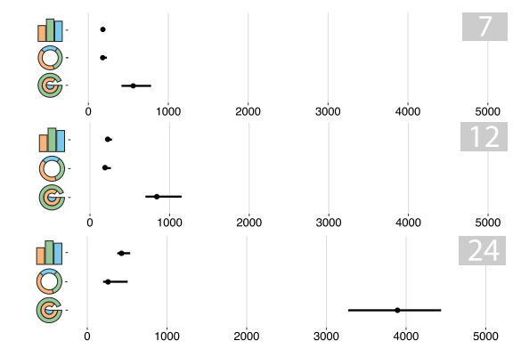
Notes:
They found that radial bar chart is the worst one in terms of glanceability. It takes time for people to understand this graph compared to two other types of graphs

Slide 10
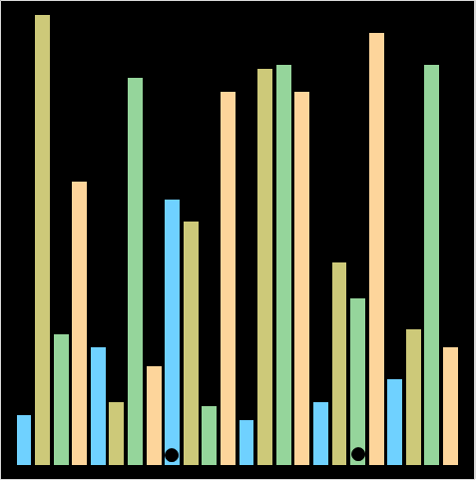
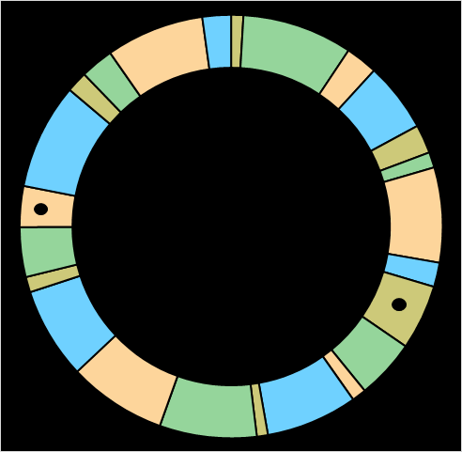
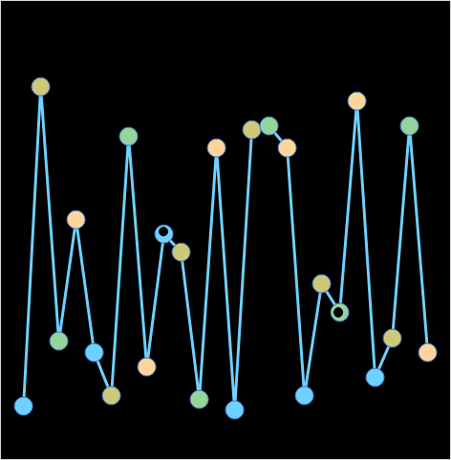
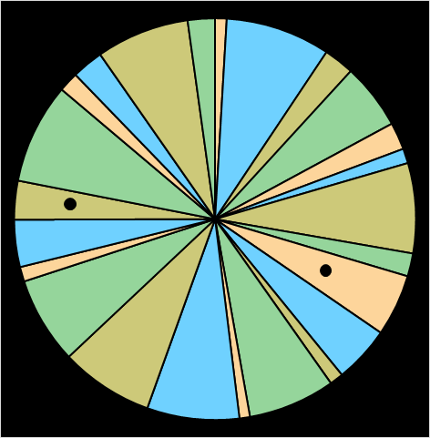
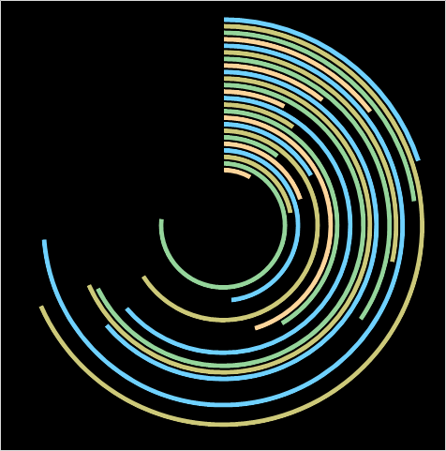

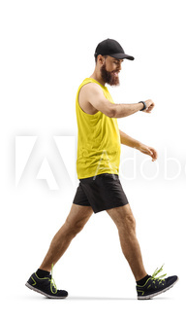
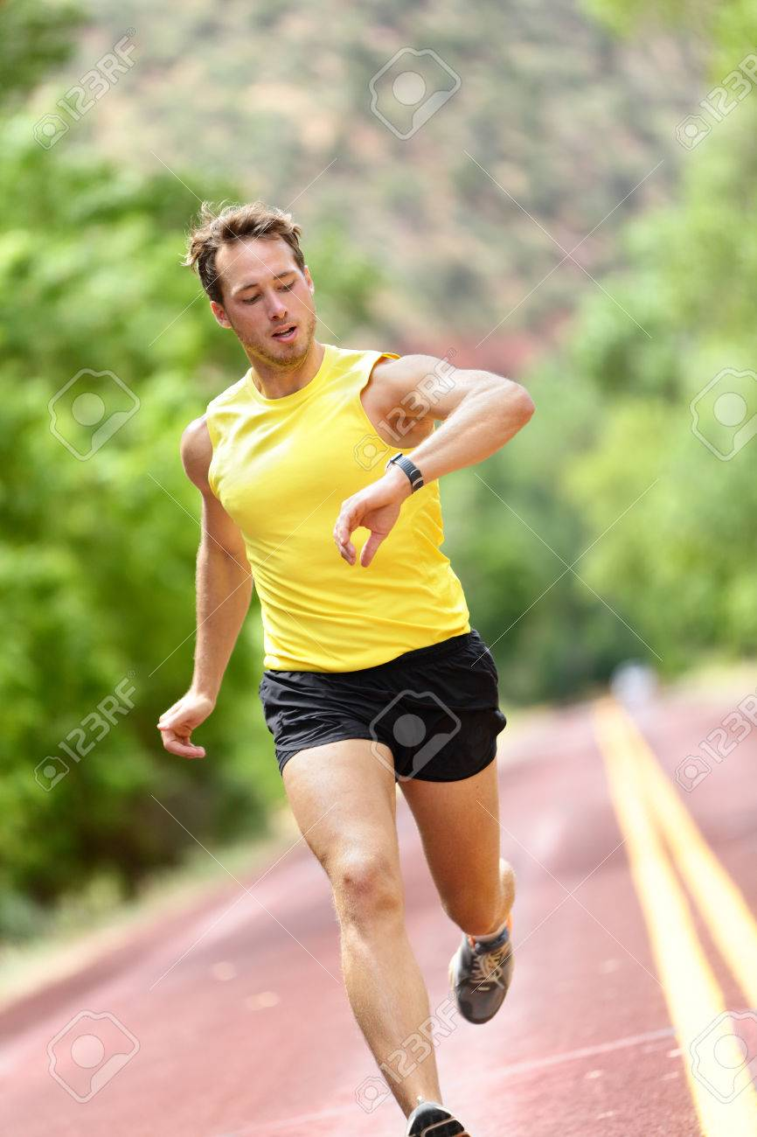
In-situ Visualization Project
Standing
Walking
Running
Notes:
Inspired by the previous study we conducted a new experiment. We added two other types of charts which are line chart and pie chart which are two other common visualization techniques on smartwatches. We also added three mobility conditions which are standing, walking and running.

Slide 11
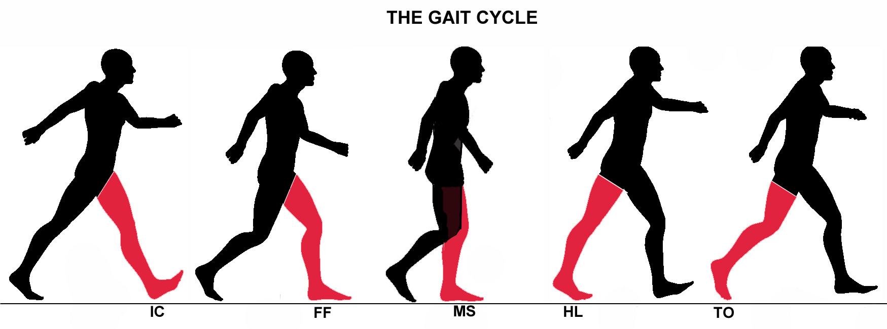
Notes:
As well as we recorded participants’ legs movements to capture gait phases while they are running / walking.

Slide 12
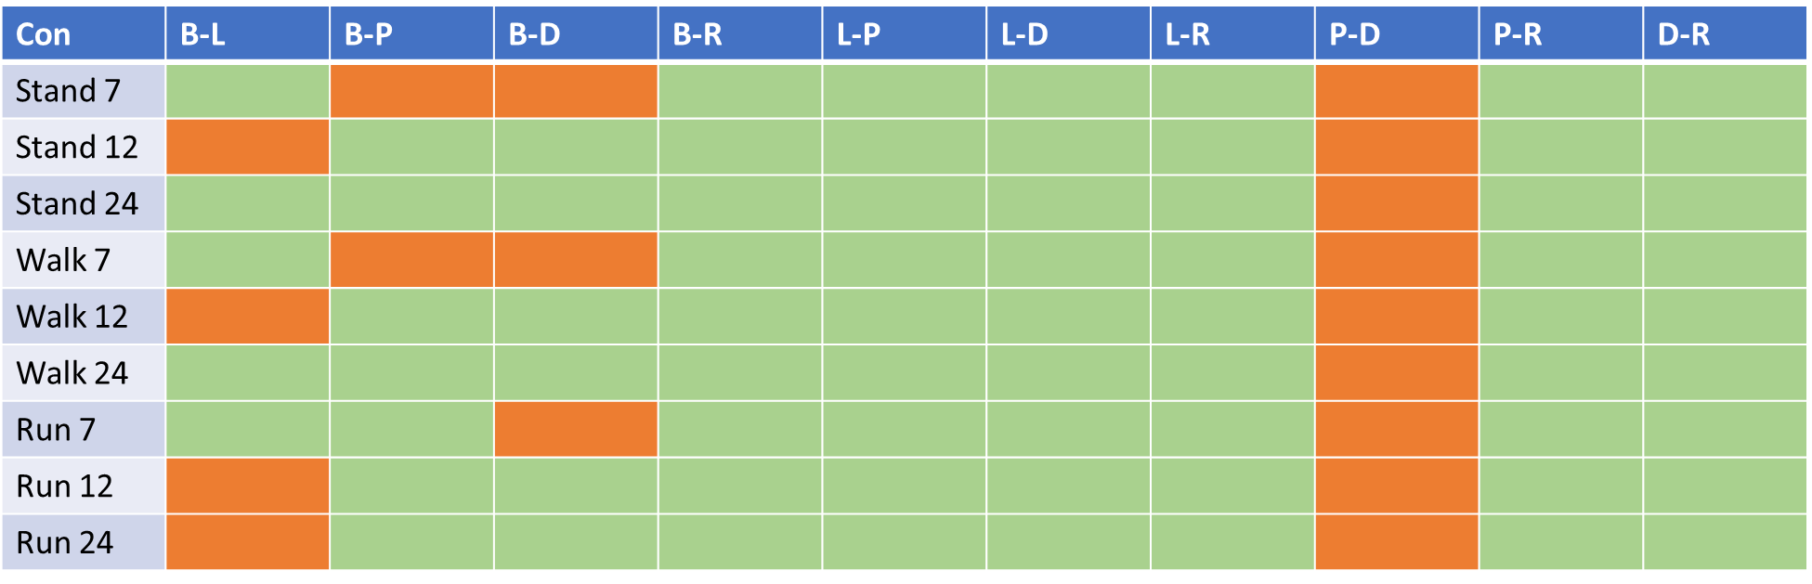
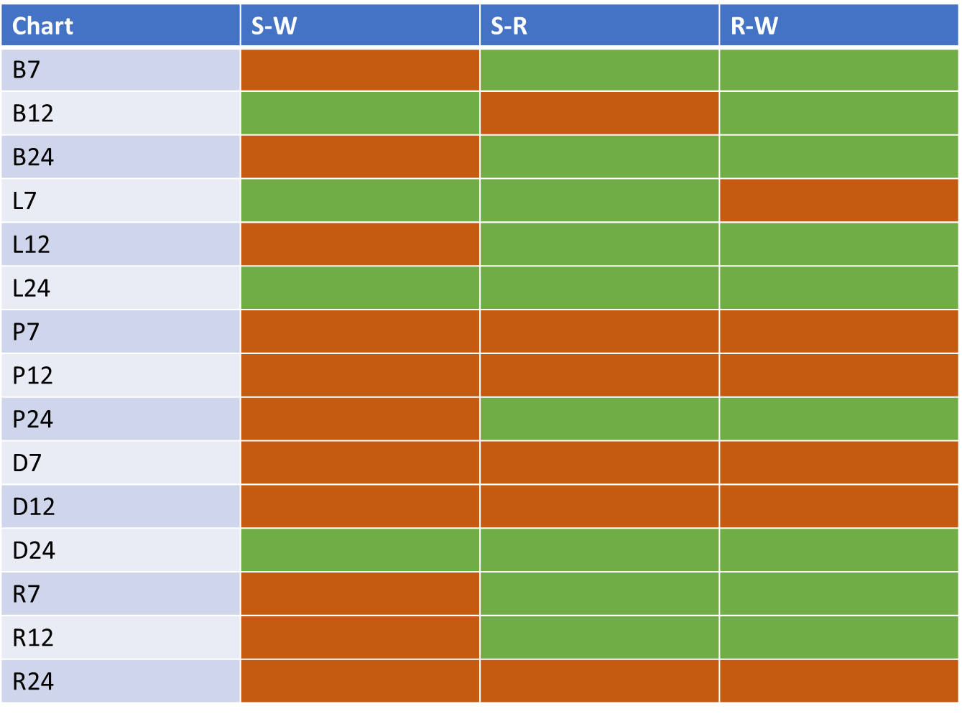
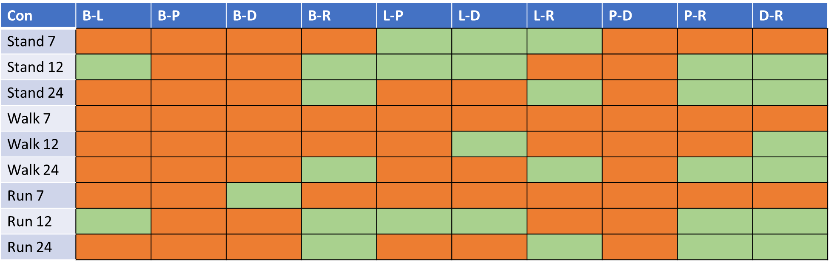
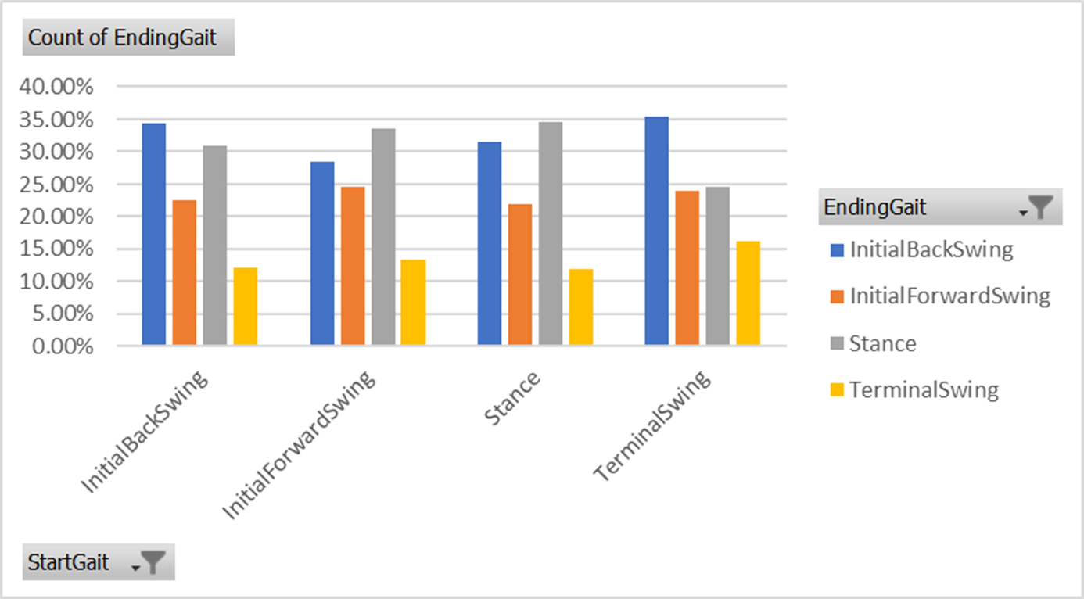
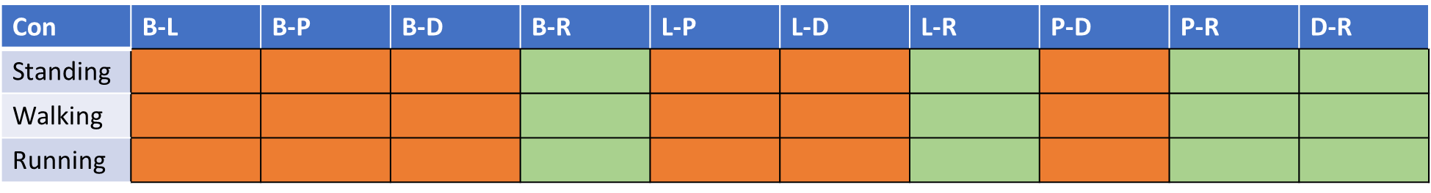
Notes:
We found interesting results both about the graphs and gait analysis in different mobility conditions which needs a separate presentation to report the result.

Slide 13

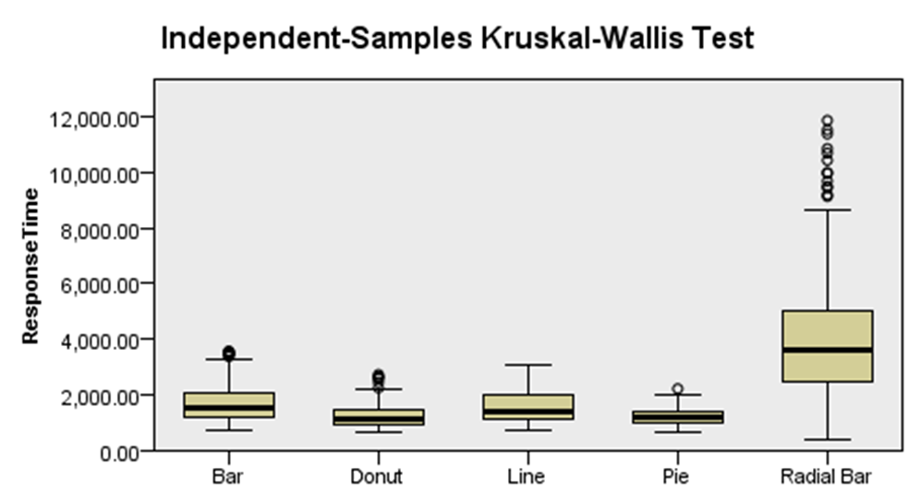
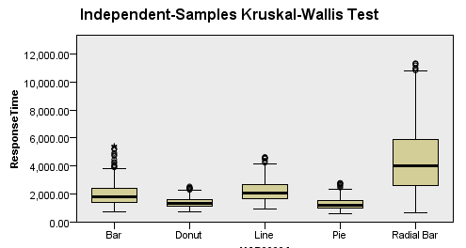
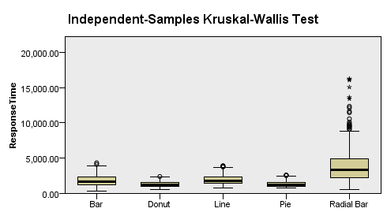
running Condition Across all Density Levels
walking Condition Across all Density Levels

Slide 14
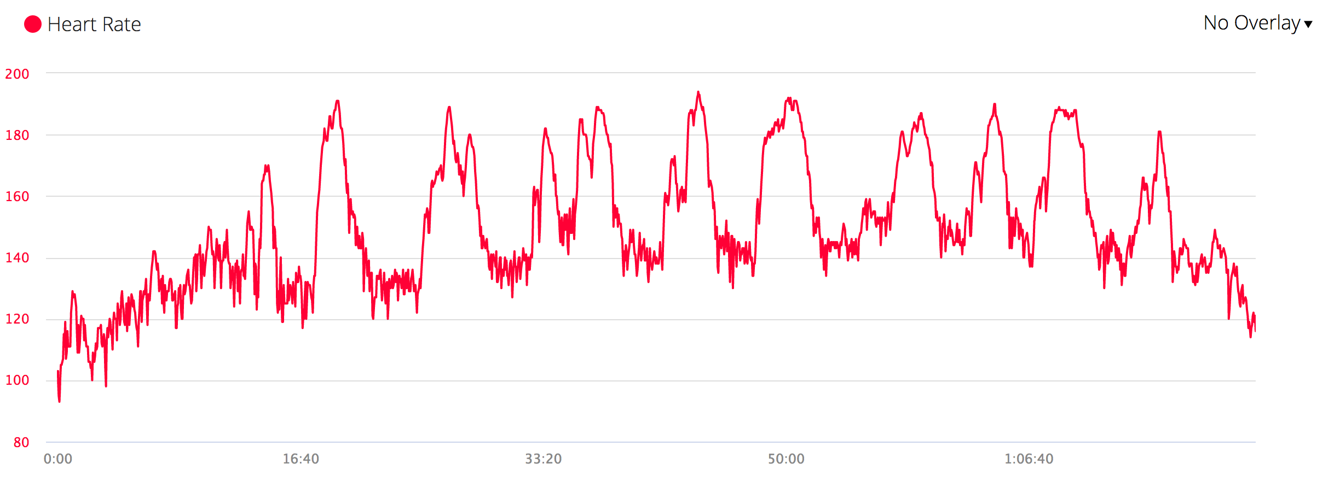
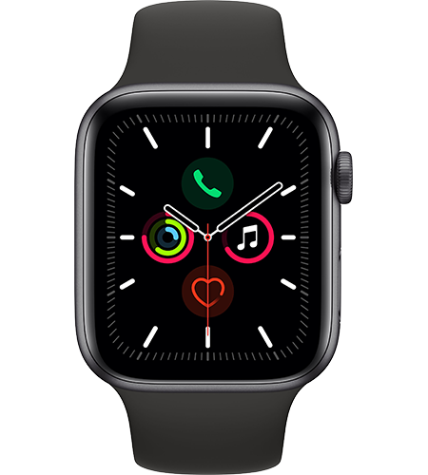
SF-LG Project
Notes:
Another study that we did is the Space Filling Line Graph project
For a sensor such as heart rate sensor which is collecting the data with relatively high sample rate. That would be challenging to represent this massive data on the small screen of smartwatch.

Slide 15
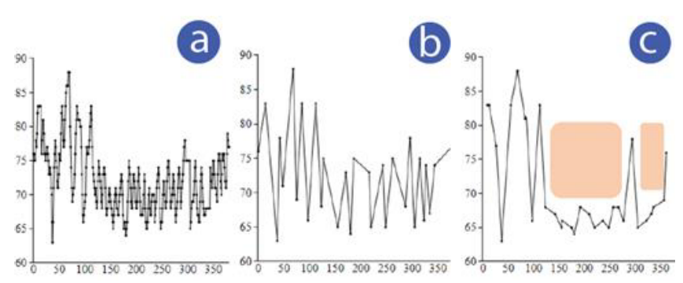
N-Simplified
PIP
SF-LG
Notes:
One of the techniques to improve the glanceability of the graphs is simplification technique.
By using this technique we can make the graph simpler and easy to understand on the smartwatch.
So the left graph here is the complex graph with around 360 data points
the middle is a well-known techniques to simplify the line graph based on visually important data points which is called PIP or perceived important points,
And the right one is our algorithm to simplify the graph which is even simpler than PIP

Slide 16
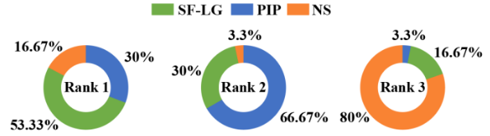
Notes:
We showed that SF-LG works better in terms of error rate and response time compared to PIP and Non simplified
Also participants preferred our method

Slide 17
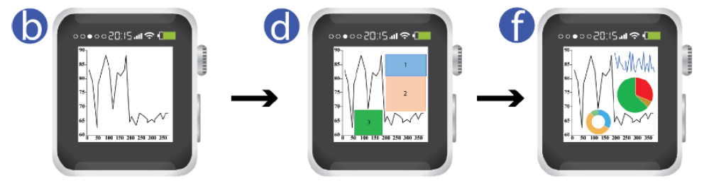
Notes:
Also we’ve come up with a greedy algorithm to allocate the generated spaces around the simplified graph to add auxiliary information based on the information we want to add to the simpered graph

Slide 18
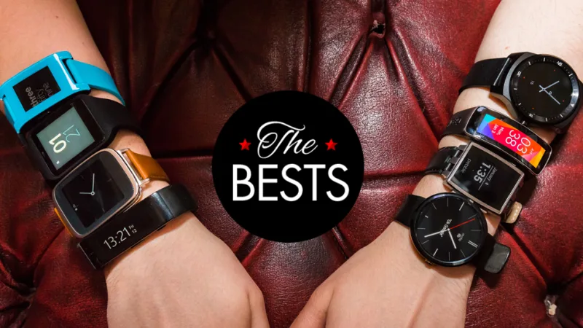
Small Form Factor
Smartwatches
Notes:
Another challenging factor is small form factor of smartwatches which is important for many of us as HCI researchers.

Slide 19
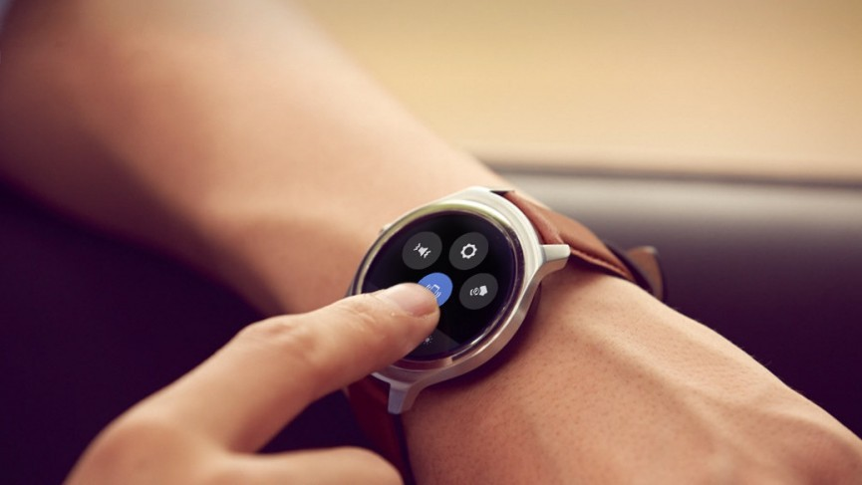
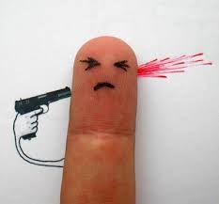
Fat Finger Effect
Fat Finger Effect
Notes:
This small form factor can cause an effect which is called fat finger effect which is happening when you want to interact with the screen but your finger blocks the area you want to interact with on the screen
This is a common challenge on smartwatches

Slide 20
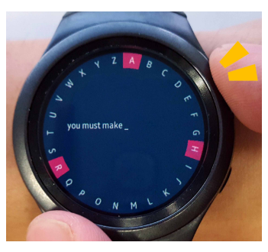
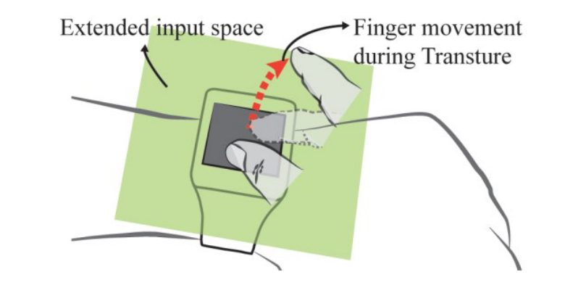
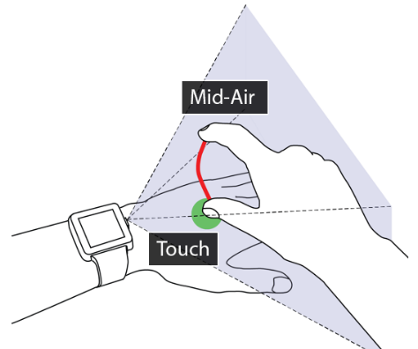
Sridhar S, Markussen A, Oulasvirta A, Theobalt C, Boring S. WatchSense: On-and above-skin input sensing through a wearable depth sensor. InProceedings of the 2017 CHI Conference on Human Factors in Computing Systems 2017 May 2
Yi X, Yu C, Xu W, Bi X, Shi Y. Compass: Rotational keyboard on non-touch smartwatches. InProceedings of the 2017 CHI Conference on Human Factors in Computing Systems 2017 May
Han J, Ahn S, Park K, Lee G. Designing Touch Gestures Using the Space around the Smartwatch as Continuous Input Space. InProceedings of the 2017 ACM International Conference on Interactive Surfaces and Spaces 2017 Oct 17
Notes:
This is why there are many different novel interaction techniques for specific tasks such as text entry

Slide 21
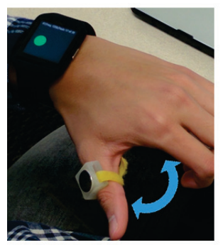
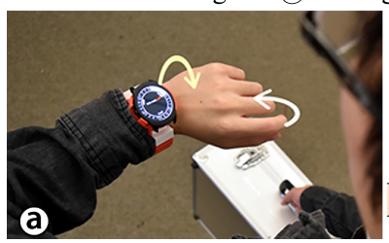
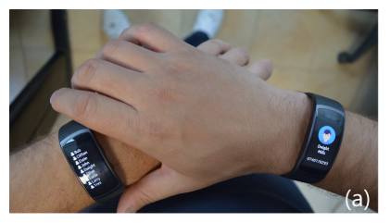
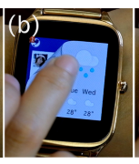
Han T, Li J, Hasan K, Nakamura K, Gomez R, Balakrishnan R, Irani P. PageFlip: Leveraging Page-Flipping Gestures for Efficient Command and Value Selection on Smartwatches. InProceedings of the 2018 CHI Conference on Human Factors in Computing Systems 2018 Apr 21 (p. 529). ACM.
Cioată PV, Vatavu RD. In tandem: Exploring interactive opportunities for dual input and output on two smartwatches. InProceedings of the 23rd International Conference on Intelligent User Interfaces Companion 2018 Mar 5 (p. 60). ACM.
Gong J, Xu Z, Guo Q, Seyed T, Chen XA, Bi X, Yang XD. Wristext: One-handed text entry on smartwatch using wrist gestures. InProceedings of the 2018 CHI Conference on Human Factors in Computing Systems 2018 Apr 21 (p. 181). ACM.
Reyes G, Wu J, Juneja N, Goldshtein M, Edwards WK, Abowd GD, Starner T. SynchroWatch: One-handed synchronous smartwatch gestures using correlation and magnetic sensing. Proceedings of the ACM on Interactive, Mobile, Wearable and Ubiquitous Technologies. 2018 Jan

Slide 22
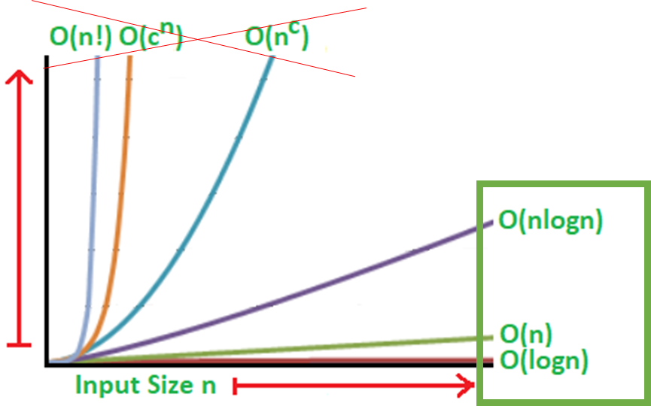
Limited Computing and Memory Capabilities
Notes:
The other challenge is limited memory space and computing capabilities on smartwatches
So basically for all the techniques we want to deploy on smartwatches, including data visualization techniques, specially for steaming data, this is a factor we need to consider.

Slide 23
Project: Data Visualization Interaction on Smartwatch
Notes:
This is the second part of the presentation which we will talk about a new project we are conducting soon related to interaction with line graphs on smartwatches.

Slide 24
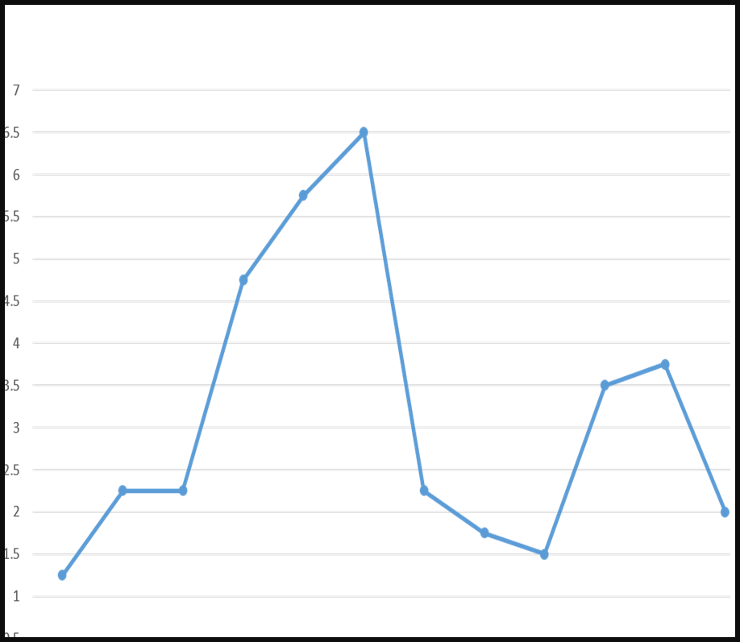
The Most Common Tasks
Single Value Detection
Data Values Comparison
Min / Max Detection
Trend / Pattern Detection
Notes:
There are many tasks related to understanding and reading a graph.
These are the most common ones based on the previous works
The first one is single value detection

Slide 25
The Most Common Tasks
Single Value Detection
Data Values Comparison
Min / Max Detection
Trend / Pattern Detection

Slide 26
The Most Common Tasks
Single Value Detection
Data Values Comparison
Min / Max Detection
Trend / Pattern Detection

Slide 27
The Most Common Tasks
Single Value Detection
Data Values Comparison
Min / Max Detection
Trend / Pattern Detection

Slide 28
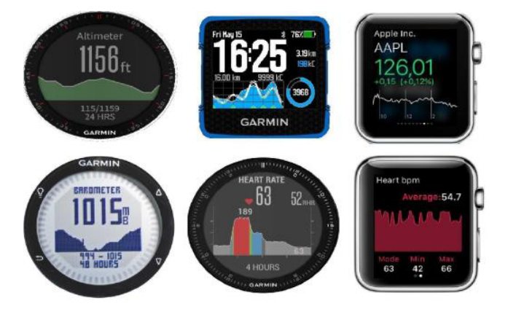
Line Graphs
Notes:
The focus of this experiment is to interact with line graphs as they are very common on smartwatches.

Slide 29
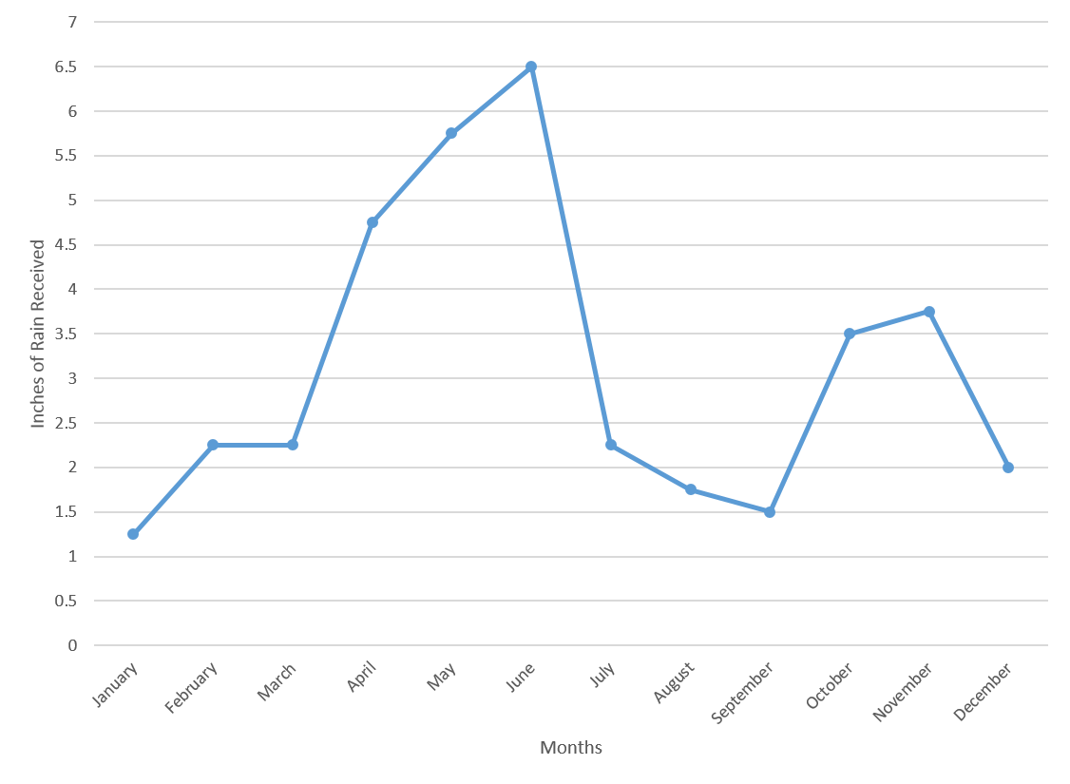

Slide 31
Single Value Detection
Data Values Comparison

Slide 32
Single Value Detection

Slide 33
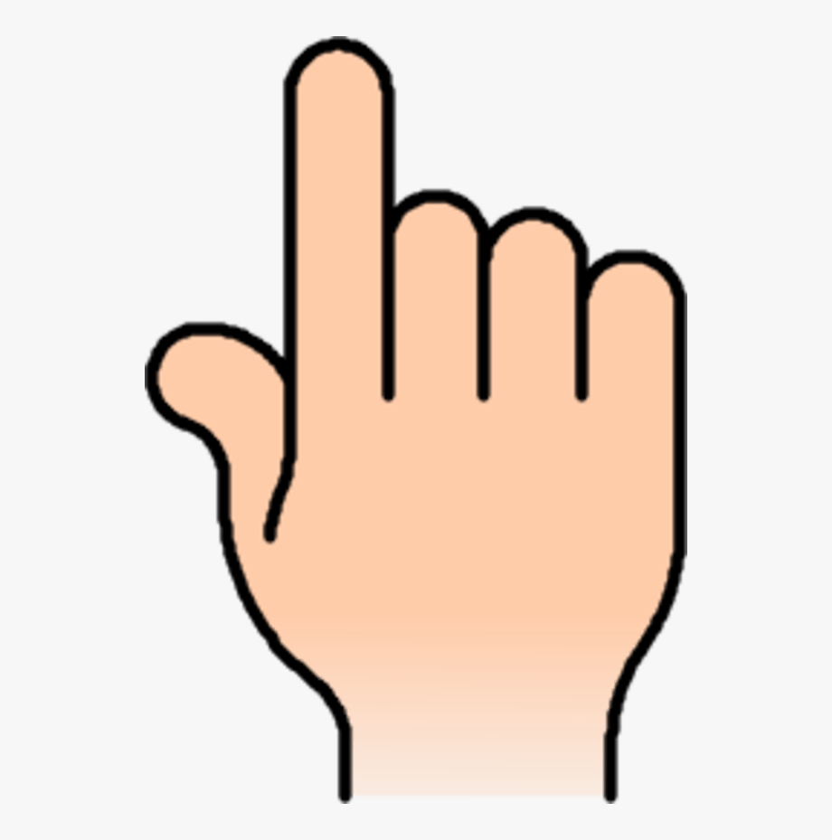
3.7
Notes:
Touch section and a line appears

Slide 34
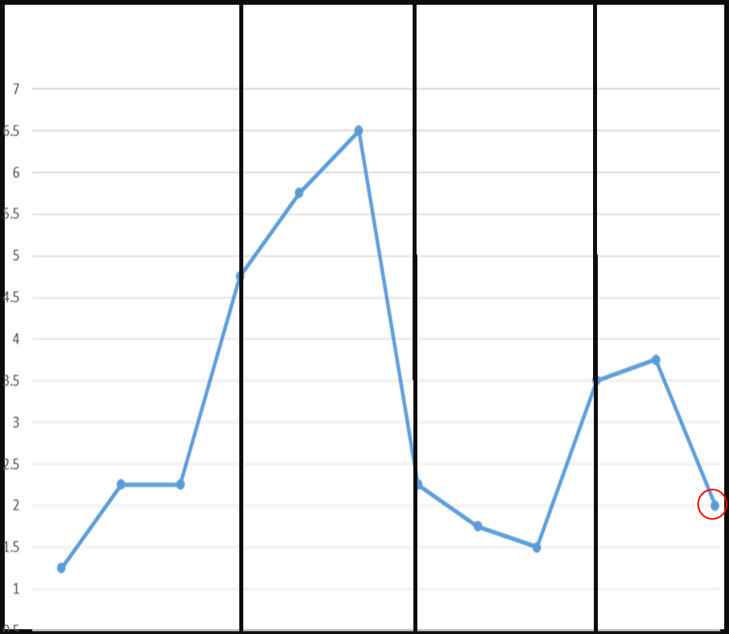
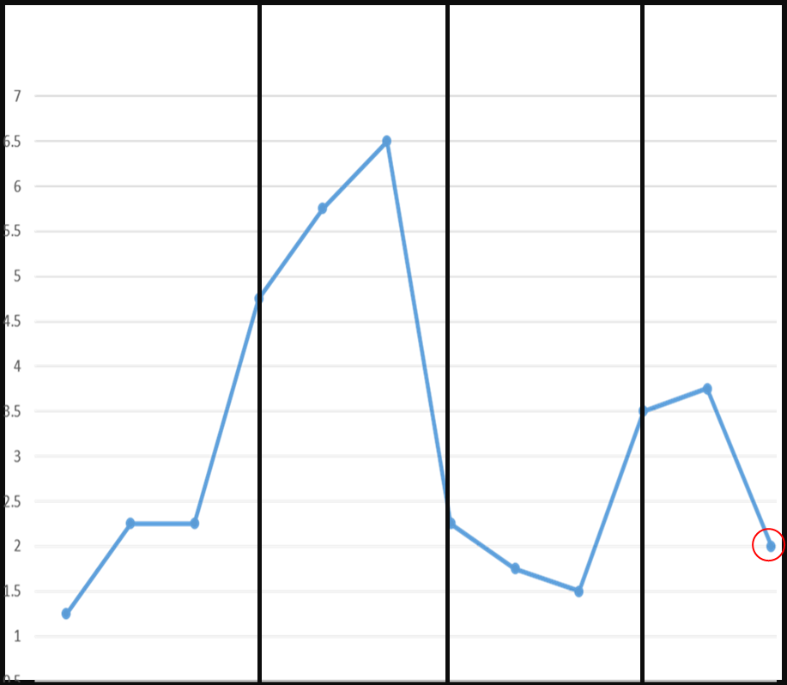
3.7
2

Slide 35
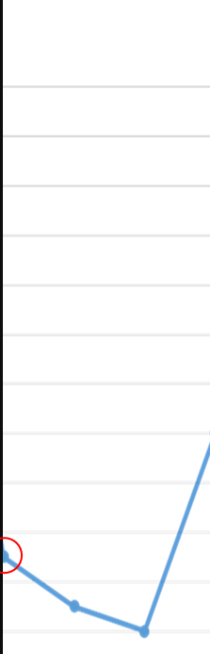
1.5
2.7

Slide 36
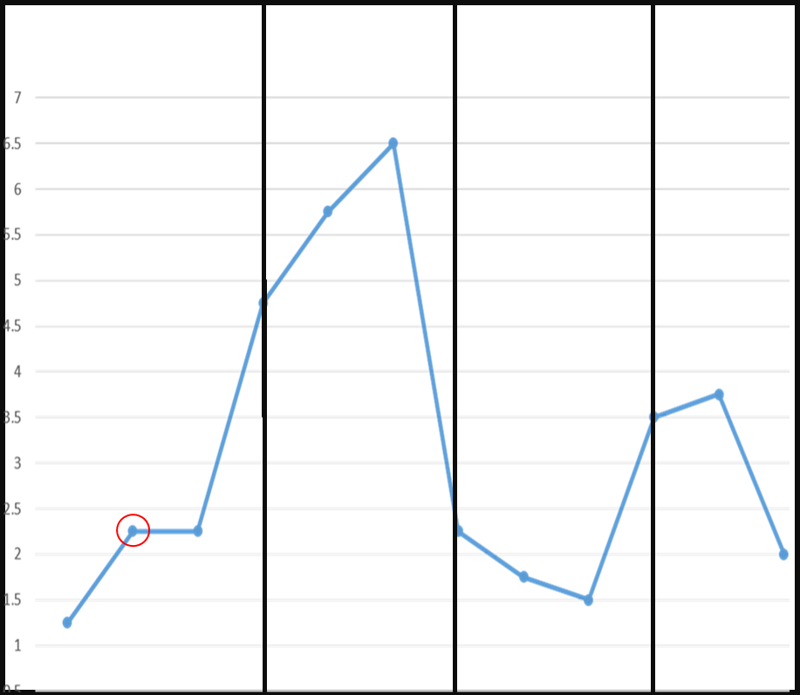
1.3
2.4

Slide 37
Local Max/Min
Mean of Data Points

Slide 38
v

Slide 39
Data Values Comparison

Slide 40
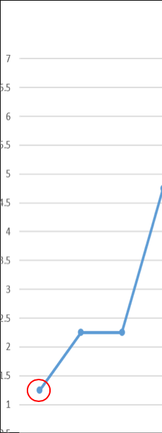

+2.1

Slide 41
Step 1

Slide 42
1.2

Slide 43
Study 1
Tasks
Data Detection
Data Comparison
Independent Variables
Data Density (7, 12, 24)
Number of Sectors (4, 5, 6)
Horizontal / Vertical
Dependent Variables
Response Time
Error Rate

Slide 44
Study 2
Independent Variables
Our Method vs Shift Technique
Tasks
Data Detection
Data Comparison
Dependent Variables
Response Time
Error Rate

Slide 45
Study 2
Independent Variables
Our Method vs Shift Technique
25
Tasks
Data Detection
Data Comparison
Dependent Variables
Response Time
Error Rate

